Slide 1
Providing Gospel-Inspired Learning Experiences for EAL/D students
Jennifer Thomas & Clare Midgley

Slide 2

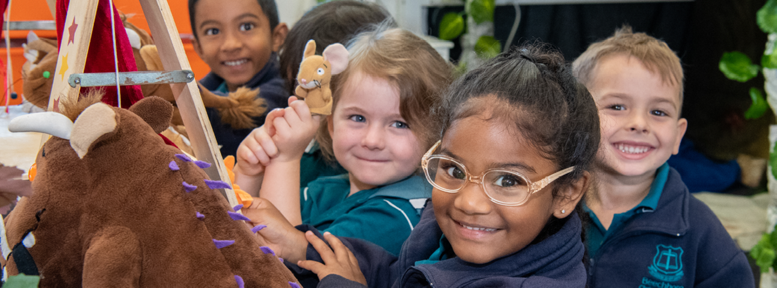
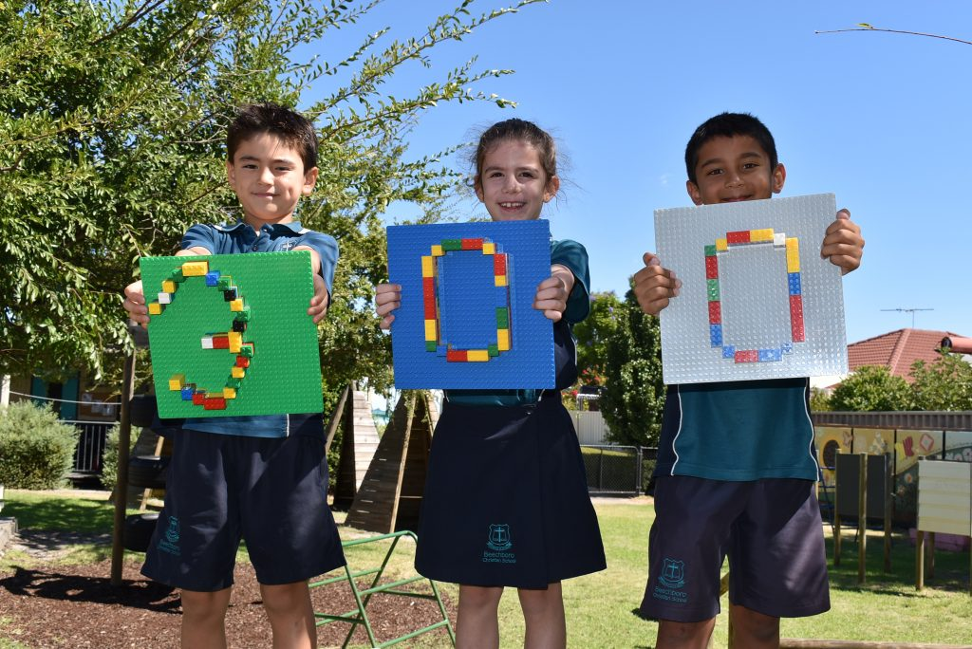
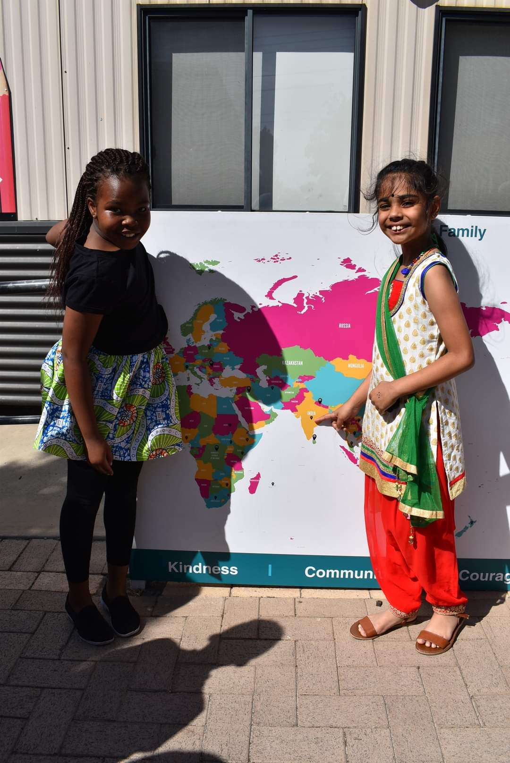
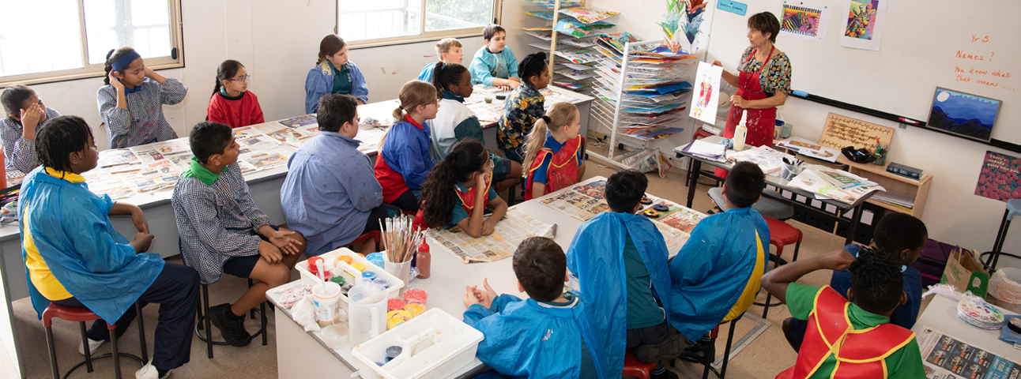
Our BCS Journey

Slide 3

Culture Club!
Embrace diversity
Value cultural richness
Faith and culture are not the same – comments from parents
Adapt
Culture is everyone’s responsibility

Slide 4
Knowing Our Families
Needs a strategic approach
Families need to know they belong
Harmony Day
Grandparents’ Day
Tone of tours
Inviting families into class
Links e.g. with Temples – visits / invites to staff meetings
Cultural considerations

Slide 5

Our Attitude
All learning requires growth mindset
Do you come to things from a place of optimism? i.e. all children regardless of background can learn
Analysing your class
EAL/D learners are one group
All children are capable learners

Slide 7
Who are EAL/D students?
EAL/D students are those whose first language is a language or dialect other than English and who require additional support to assist them to develop proficiency in English.
EAL/D students come from diverse, multilingual backgrounds and may include: overseas and Australian‐born students whose first language is a language other than English
Aboriginal and Torres Strait Islander students whose first language is an Indigenous language, including traditional languages, creoles and related varieties, or Aboriginal English.

Slide 8
Progress Maps
The purpose of the EAL/D Progress Map is to:
• respond to and represent all EAL/D students in Western Australia positively and equitably
• identify EAL/D students who require EAL/D language support from Kindergarten to Year 12
• describe student progress across listening, speaking, reading and viewing and writing modes in four phases of schooling – early childhood, middle childhood, early adolescence and late adolescence
• acknowledge the existing language skills and abilities of EAL/D students
• assist teachers to plan meaningful teaching and learning programs
• provide explicit information for teachers to make accurate judgements about EAL/D student progress and achievement in learning SAE
• provide an effective and valid means of reporting EAL/D student proficiency in SAE.

Slide 9
Classroom tips
Clear, specific teaching of content using visuals(importance of learning intentions)
Unpack language as you go (whiteboard, butcher paper)
Read all content from subject areas as an EAL/D learner
Classroom management
Time to process and analyze new information (Carien)

Slide 11


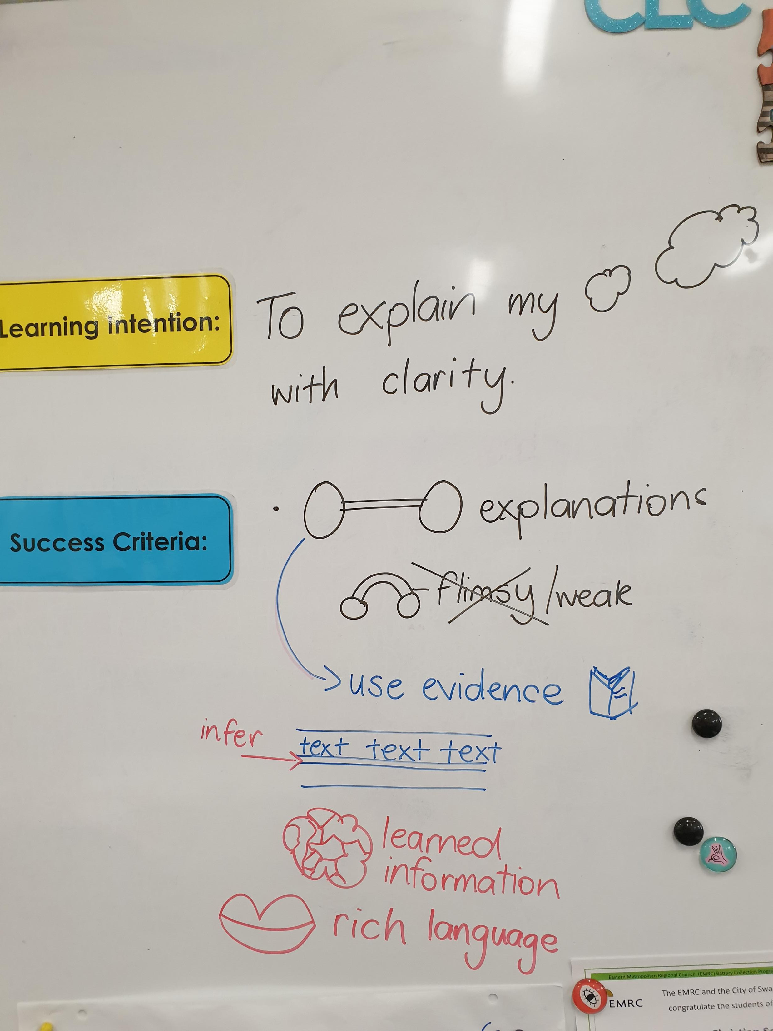
Transference of skills
What do we mean by curriculum?
Curriculum then programs...
Visible learning
Notes:
Curriculum is every moment of each child’s day
Children learn by making connections. Teaching in silos means you might end up teaching the same thing again and again
Look for skills to use in learning intentions – all adults know the focus of the lesson, focus of the activity, focus of the language and focus of the assessment
Has to be a whole school approach in every lesson
Based on the skills we want our children to walk out of the door with
For EALD chd, these prompts are very important and support taking responsibility for learning

Slide 12
Learning Intentions
Define the intended purpose & outcome
Breaks learning into small systematic steps – reduces cognitive load for EAL/D
Visible – for referral to self, peer and teacher assess
Specifically describes skill, knowledge, understanding as a result of the learning
What is the learning students will take forward with them?

Slide 13
Success Criteria
Unpacks the LI & can be co-constructed
Describe what success looks like:
What steps do the students have to go through to achieve the LI?
Are they systematic?
Are they short, snappy & simple? Using symbols/pictures?
Can they be referred back to?
I can statements

Slide 14
Oral language
Natural/innate to humans
Every conversation counts!
Enunciation & articulation
What kinds of areas might children need support with?
Past tense, sentence construction, comprehension
Supporting all children:
Model – Recast - Extend

Slide 15
Modelling: providing correct models of speech through everyday conversation, self-talk (talking through what you are doing)
Recasting: done immediately, repeating an error utterance back with the error corrected, without criticism or disruption to flow of conversation e.g., the cat goed upstairs
Extending: providing deeper modelling to add to children’s understanding e.g. I think she went upstairs to lie in the sunny spot on the landing. Cats like to bask in the warmth.

Slide 16
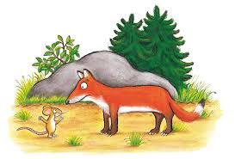
A mouse took a stroll through the deep dark woods.
How would you explicitly unpack this language?
How is a stroll different from a walk?
What does deep mean in this context?
Why might the woods be dark in daytime?

Slide 19
Things to consider
Audit culture
Know your families
Know your students
Collective efficacy
Remember it’s a journey

