Slide 1
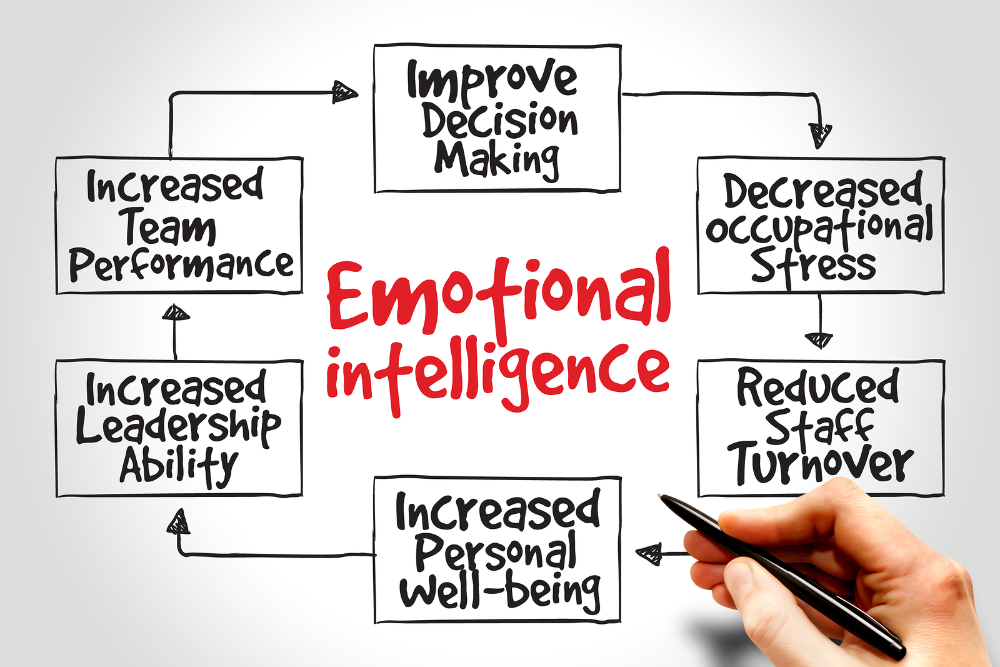

Slide 2
Key to Successful Teams - Emotional Intelligence

Slide 3
Key to Success in Sport - Emotional Intelligence

Slide 4
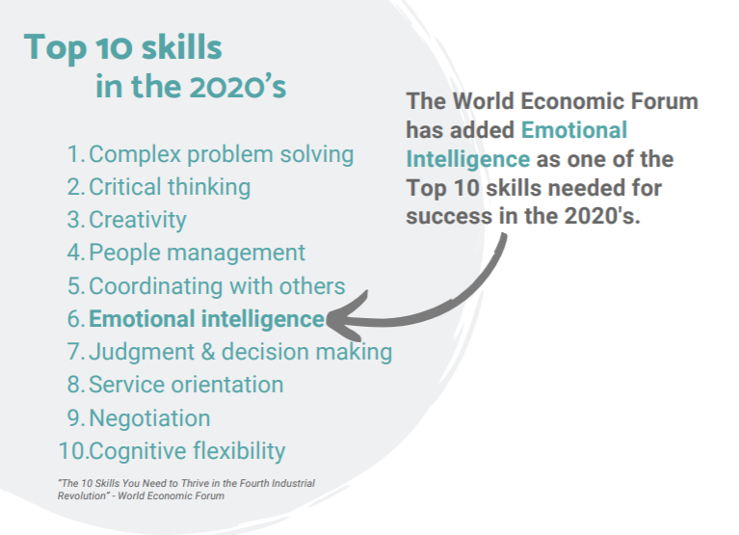

Slide 5
Emotional Intelligence – Key to Academic and Life Success

Slide 6
Key to Positive Wellbeing Emotional Intelligence

Slide 7
EQ of Learning

Slide 9
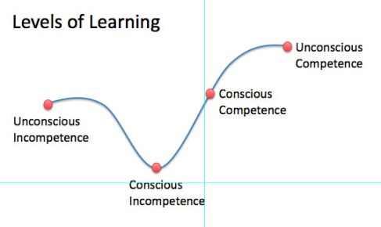

Slide 10
Schools are emotional places
Students fail assessments
Teachers a lot to do, no time!
Not enough relief teachers!
We work with teenagers…(say no more)
We have to do PSA’s and get feedback from teenagers…
Upset parents phone and email us…
How do you deal with unpleasant emotions?

Slide 11
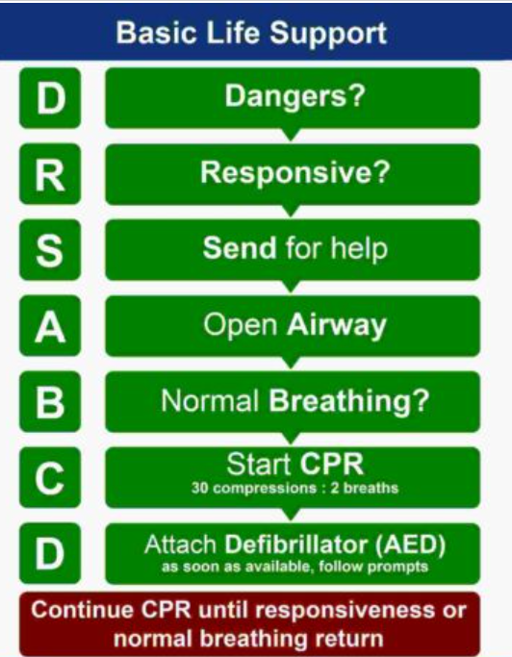
What is the best way to respond to medical situations?

Slide 12
Today’s Essential Questions 1. What is the best way to respond to emotional situations? 2. What are the fundamental EQ skills and their application to: - negotiation - connecting - teaching - leading

Slide 13
Think of:
An ongoing negative situation at work…
What emotions are associated with this situation?

Slide 14
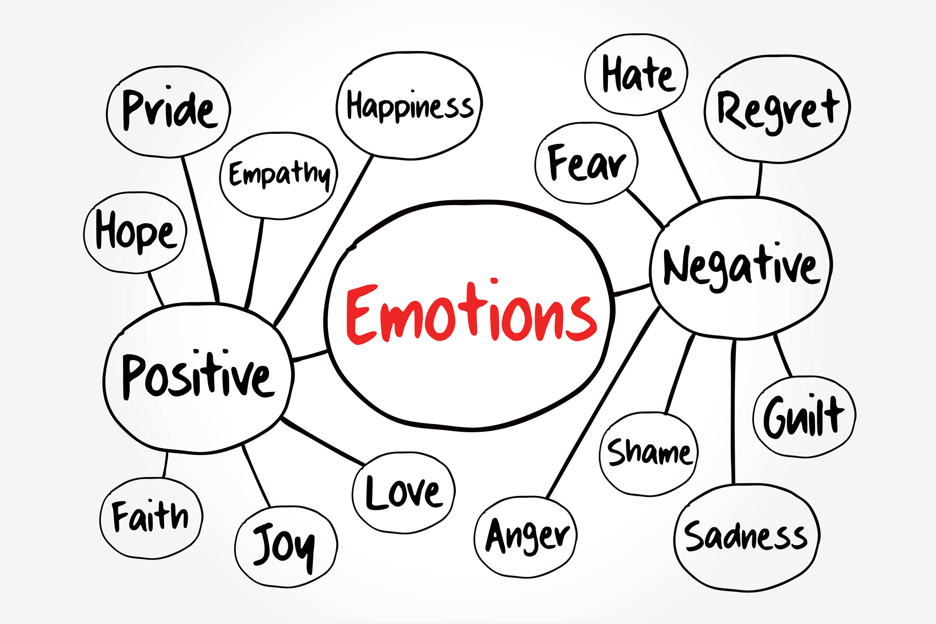
What is EQ?... the ability to understand, create and respond helpfully to your emotions and other peoples.

Slide 15
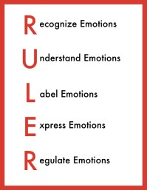
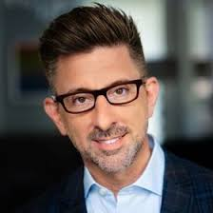
6 Fundamental EQ Skills
Professor Marc Bracket (YALE University)

Slide 16
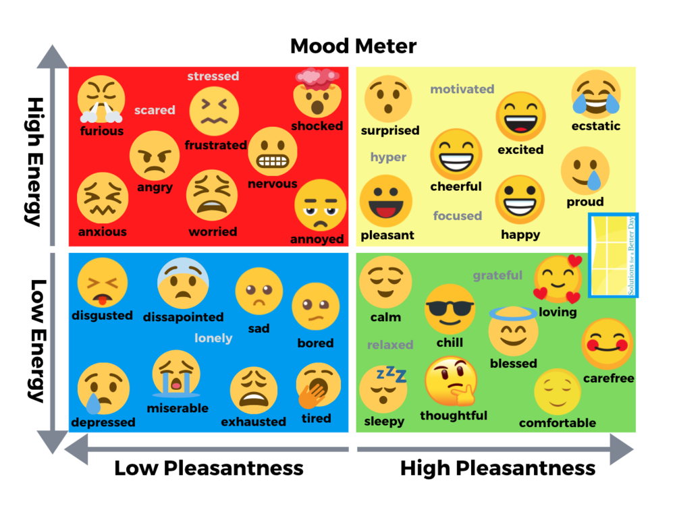
The ideal emotional state (mood) for learning?

Slide 17
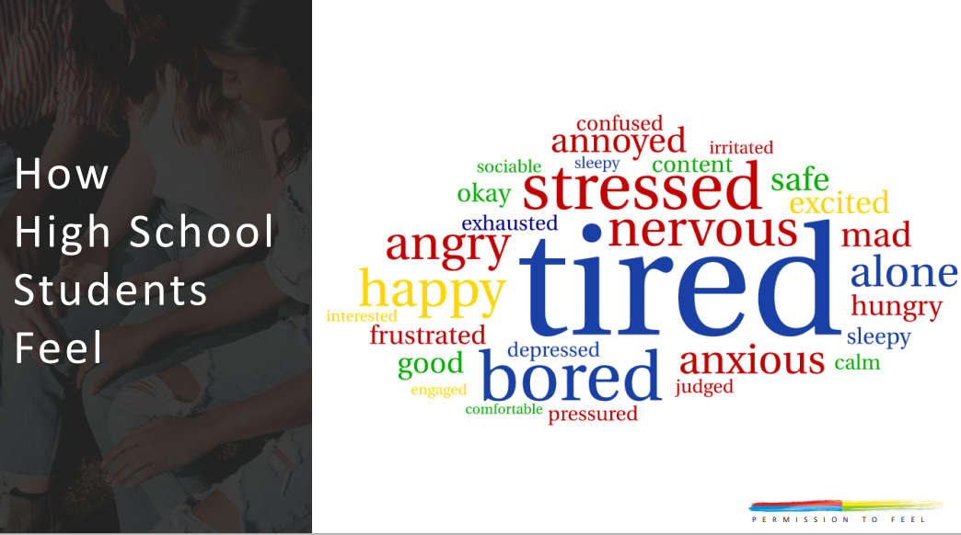

Slide 20
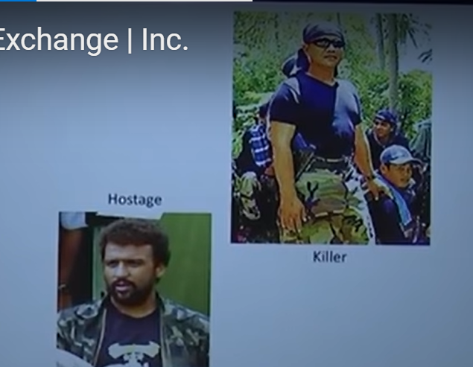
EQ is important and powerful. Agree?
‘I want
$10 000 000 or I’ll kill the American’
How would you negotiate?

Slide 21
Would you like to negotiate paying $12000 for a car worth $19000… What strategies would you use?

Slide 23
Negotiate from $10 000 000 to $0 and prisoner released by…
Make the terrorist feel heard.

Slide 24
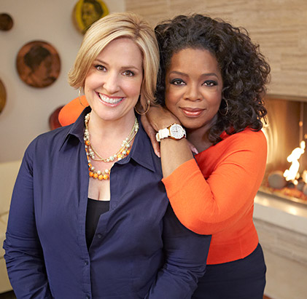
Brene Brown - ‘Empathy is the key to connection’
Empathy involves active listening to what they are:
Saying (content)
Feeling (emotion)
And showing you care.
You
‘So what you are saying is…’
‘You must be feeling…’
‘Man that is really tough…’
Them
‘Yes that’s right …connection’

Slide 26
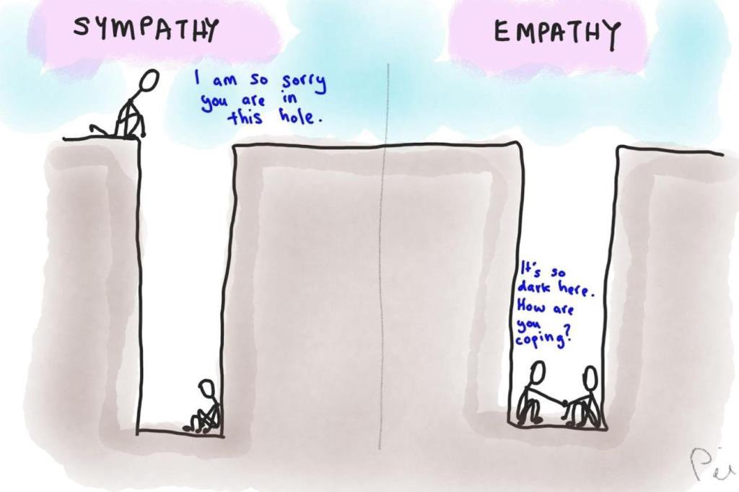

Slide 27
Connection and negotiation using empathy uses which Fundamental EQ Skills?
Professor Marc Bracket (YALE University)

Slide 28
To understand and label emotions you need to know the difference between emotions… Do you?
Anxiety – how you feel when you perceive there is a threat.
Finish these sentences…
Anger – how you feel when…
Frustration – how you feel when…
Sadness – how you feel when…

Slide 29
Emotion Vocabulary
Anger – how you feel when there is injustice.
Frustration – how you feel when your expectations are not met
Sadness – how you feel when you lose something that matters
Anxious…
Guilt …
Shame …
Vulnerable…

Slide 30
Emotion Vocabulary
Increasing students emotion vocab empowers them to better:
Understand and express how they feel
Start to process their feelings
Connect with others

Slide 31
Uncontrolled emotions stuff things up…
So angry - messed up my friendship
So frustrated - Lost my job
So anxious - Failed my driving test
So rejected – dangerous distraction
So sad – alcohol, drugs
So stressed – messed up the exam
Agree?

Slide 32
0/20 for an essay
Name it to tame it
Step 1 – understand the cause
‘Now I’ll drop to a C grade’
‘What will Mum and Dad think?’
‘This teacher can’t mark!’
Step 2 – specifically name the emotion

Slide 33
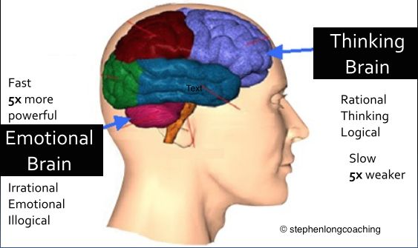
Why does naming it to tame it work?
Notes:
The process of thinking what specifically matters to me in this situation and what emotion is that shifts your brain from the emotional part to the thinking part. This automatically reduces the intensity of your emotion bringing the emotion more under control enabling you to think about the best way to respond.

Slide 34
Your car has warning lights for oil and temperature to prevent overheating…
Their body…
Notes:
The process of thinking what specifically matters to me in this situation and what emotion is that shifts your brain from the emotional part to the thinking part. This automatically reduces the intensity of your emotion bringing the emotion more under control enabling you to think about the best way to respond.

Slide 35
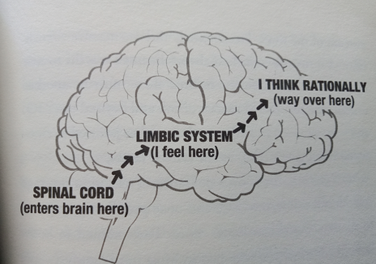
Your body has an emotional early warning system too… What it is?
Warm feelings
Sweaty palms
Racing heartbeats
Tight chest
or ???
Notes:
The process of thinking what specifically matters to me in this situation and what emotion is that shifts your brain from the emotional part to the thinking part. This automatically reduces the intensity of your emotion bringing the emotion more under control enabling you to think about the best way to respond.

Slide 36
Controlling emotions…
Recognize – body signals
Understand cause of emotion
Label specifically
When…
In a meeting…
Driving home…
In the classroom…

Slide 37
Expressing Emotions ‘A problem shared is a problem halved’
Helpful expression
Involves the right place, time, person or God (prayer), tone
Reduces the intensity of unpleasant emotion
Unhelpful expression…

Slide 38
Regulating Emotions Includes:
Increasing and extending pleasant emotions.
Creating helpful emotions
Reducing intensity and changing unpleasant emotions

Slide 39
Strategies to Regulate (reduce or change unpleasant) emotions
Deep breathing
Focus your thoughts on other things
Listen to or play music
Exercise
Colouring in or read a book
Smile (hold a pencil in your teath)
Call a friend
Watch a comedy or tv show
Eat yummy food, wine…
etc

Slide 40
Which fundamental EQ skill did Marc miss?
Think
Professor Marc Bracket (YALE University)

Slide 41
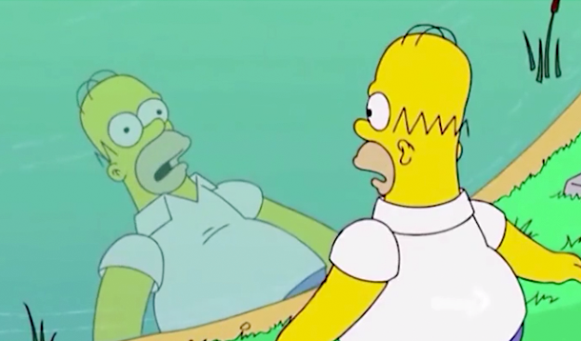
You must Think before you express or regulate your emotions may be wrong or unhelpful.

Slide 43
How do you feel about your body?
Situation + thoughts or story → emotion
School + __________ → ____
School + ____________→ _____

Slide 44
How do you feel about school?
Situation + thoughts or story → emotion
School + __________ → _annoyed_
School + ____________→ _a__

Slide 45
She’s angry as she only got a $15 000 car for her birthday. ’
Situation + thoughts → emotion
$15 000 car + thoughts comparing to rich friend → anger
$15 000 car + thankful thoughts → joy + thankfulness

Slide 46
Situation - You become aware that your line manager has done something in your area of responsibility without your knowledge. Your feel…
Situation + thoughts or story → emotion
Line manager action + he is unhappy with my work → ____
Line manager action + that is not right → _________

Slide 47
How does she feel? Are her feelings, right? Why?

Slide 48
Emotion Vocabulary
Anger – how you feel when there is you perceive an injustice.
situation + thoughts → emotion
(judgements)

Slide 49
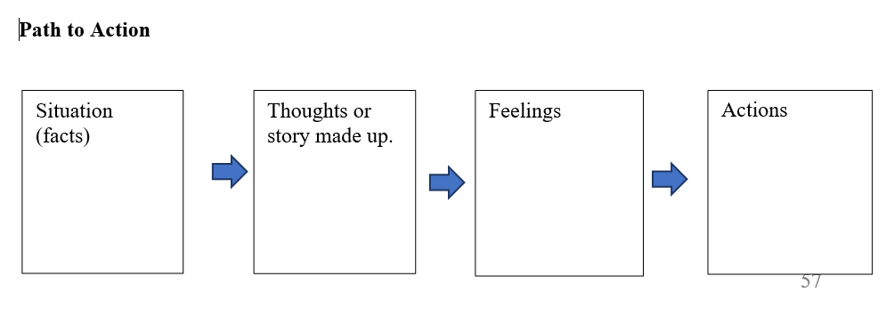
Activity - consider your ongoing negative situation that caused unpleasant emotions… 1. Complete a path to action for your regular thoughts/story and resultant feelings

Slide 50
The thoughts and stories you and others make up are not random, they flow out of our chosen…
Mindsets
Perspectives
Hearts
Experiences
Prior knowledge, theology

Slide 51
Reframing… Now complete an alternate path to action with alternate thoughts/story and resultant feelings. Eg this is an opportunity for me to grow ☺

Slide 52
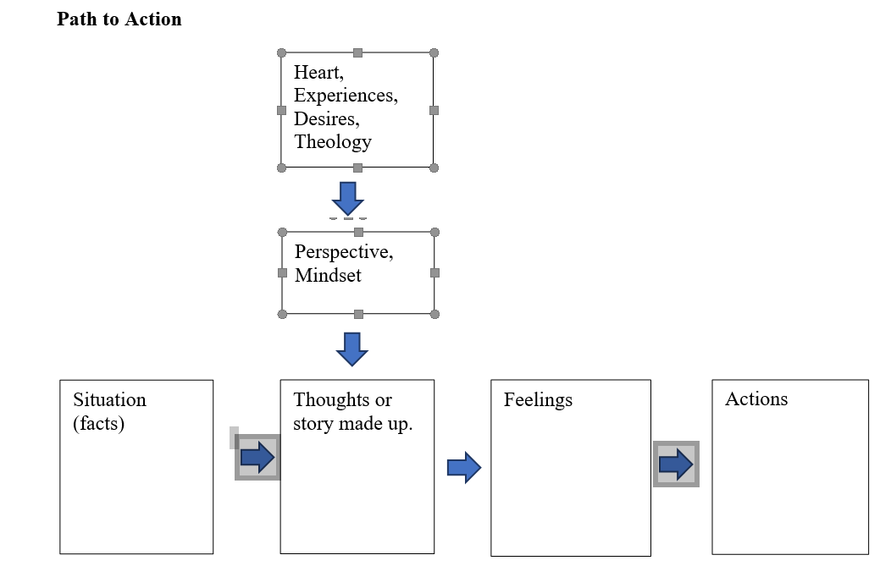

Slide 53
Before expressing and regulating think… What thoughts, story or perspective is contributing to my feelings? Are my feelings right?
Think

Slide 54
Think... How is this feeling impacting me? Helpful? What impact do I want to have on this situation?
Think

Slide 55
Creating emotions/moods/atmospheres… Reframing Application to teaching and leading
Situation + thoughts/story → emotions/
atmospheres
Helpful dissatisfaction (motivation) at the start of term.
Satisfaction and self efficacy mid term
Feeling of valued and appreciated end of term

Slide 56
Application - Responding to Emotional People
Situation – My daughter did no study 2 days before the WACE exam
Response?
Think
Note
Help others to RULTER if they want it.
RULTER is not for people in fight, flight or freeze mode.
I most need to RULTER when I don’t want to…

Slide 57
RULTER is my first go to strategy and then I choose a helpful strategies such as…
Deep breathing
Focus your thoughts on other things
Listen to or play music
Exercise
Colouring in or read a book
Smile (hold a pencil in your teath)
Call a friend
Watch a comedy or tv show
Eat yummy food, wine…
etc

Slide 59
Today’s Essential Questions 1. What is the best way to respond to emotional situations? 2. What are the fundamental EQ skills and their application to: - negotiation - connecting - teaching - leading

Slide 60
Workshop Survey https://forms.gle/FXJRrXjBx3fog5PK6

